Slide 2
Preprocessing
Tokenization
Remove stop words
Stemming
Lemmatizing
Part of speech tagging

Slide 3
Topic Modeling
Noun words
Term frequency–inverse document frequency for noun words
Remove most frequent and less frequent words (max_df and min_df)
LDA Parameters:
Number of topics
Learning decay (learning rate)

Slide 4
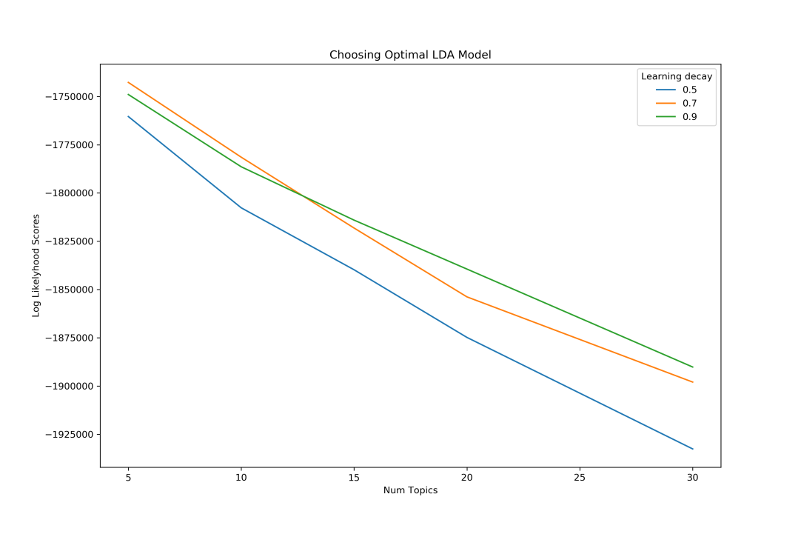
GridSearchCV
Performance measure: Log Likelihood Score and Model Perplexity
Best Model Parameters:
Log likelihood Score: -1742709.36275
Perplexity: 97.2563100719

Slide 5
Topics (Top 6 words in each topic)
Topic 1: Chicken, money, coffee, sauce, quantity, value
Topic 2: Food, Veg, Starters, Buffet, Biryani, Lunch
Topic 3: Place, Service, Ambience, Taste, Quality, Time
Topic 4: Beer, Table, Service, Drinks, Music, Friends
Topic 5: Dosa, Masala, Road, Night, Area, Soup

Slide 6
Topic distribution (Sample)
 | ReviewId | UserId | RestaurantId | Topic1 | Topic2 | Topic3 | Topic4 | Topic5
0 | 7063897 | 267955 | 54162 | 0.028932 | 0.204383 | 0.70892 | 0.028945 | 0.02882
1 | 7059469 | 20216230 | 54162 | 0.112233 | 0.015822 | 0.494437 | 0.276923 | 0.100586
2 | 7050151 | 2023120 | 54162 | 0.202774 | 0.033661 | 0.696518 | 0.033712 | 0.033334
3 | 7049203 | 20194192 | 54162 | 0.028667 | 0.346743 | 0.029633 | 0.566359 | 0.028597
4 | 7046773 | 20187610 | 54162 | 0.264663 | 0.01879 | 0.679602 | 0.018684 | 0.01826
5 | 7042579 | 2291128 | 54162 | 0.016774 | 0.932771 | 0.016914 | 0.016799 | 0.016743

Slide 7
Restaurant Topic distribution (Sample)
RestaurantId | Topic1 | Topic2 | Topic3 | Topic4 | Topic5
50008 | 0.069626 | 0.287817 | 0.393983 | 0.176829 | 0.071745
50024 | 0.403515 | 0.05799 | 0.267174 | 0.206926 | 0.064396
50031 | 0.09496 | 0.150569 | 0.400211 | 0.16618 | 0.188081
50066 | 0.09335 | 0.410048 | 0.265596 | 0.173117 | 0.05789
50121 | 0.113432 | 0.300168 | 0.354865 | 0.130583 | 0.100952

Slide 8
User Topic Distribution (Sample)
UserId | Topic1 | Topic2 | Topic3 | Topic4 | Topic5
421 | 0.241571 | 0.129223 | 0.385943 | 0.014795 | 0.228468
449 | 0.035001 | 0.207164 | 0.690298 | 0.034012 | 0.033525
1011 | 0.035627 | 0.25626 | 0.447997 | 0.191742 | 0.068373
1741 | 0.0119 | 0.388426 | 0.012275 | 0.57558 | 0.011819
1811 | 0.029063 | 0.028855 | 0.884182 | 0.029222 | 0.028679

